Slide 1

Crop Recommendation System Using Random Forest and Naive Bayes
COURSE : Machine learning
COURSE CODE: 25SC2107E
SECTION: 4
Branch: CSE
GUIDED BY: JYOTHSNA DATTI(Assistant professor)
2520030392 –B.Vishnu Vardhan
2520030280 – ch.nripendra
2026-2027

Slide 2
CONTENTS
ABSTRACT
INTRODUCTION
REQUIREMENT ANALYSIS
20 LITERATURE PAPERS IN TABLE FORMAT
DATASET DESCRIPTION

Slide 3
ABSTRACT
Agriculture plays an important role in ensuring food security and supporting economic development. Selecting a suitable crop for cultivation is a challenging task because different crops require different soil and climatic conditions. Traditional crop selection methods mainly depend on farmers' experience and knowledge, which may not always provide accurate recommendations when environmental conditions change. This project proposes a Crop Recommendation System using Python and Machine Learning to recommend a suitable crop based on important agricultural parameters such as nitrogen (N), phosphorus (P), potassium (K), temperature, humidity, pH, and rainfall. The system uses a crop recommendation dataset and performs data preprocessing to prepare the data for training and testing.
Two machine learning algorithms, Random Forest and Naive Bayes, are used to predict the most suitable crop for the given soil and environmental conditions. Random Forest combines multiple decision trees to provide reliable classification, while Naive Bayes uses probability-based classification to make predictions efficiently. The performance of both models is evaluated using accuracy, precision, recall, F1-score, and confusion matrix to compare their prediction performance. The main aim of this project is to provide a simple and useful system that can help farmers make better crop selection decisions based on soil and climatic conditions. The system can reduce guesswork, support efficient use of agricultural resources, improve crop selection, and contribute to more sustainable farming practices.

Slide 4
INTRODUCTION
Agriculture is one of the most important sectors contributing to the economy and food production across the world. With the increasing demand for food due to rapid population growth, farmers are under constant pressure to maximize crop productivity while maintaining soil fertility and efficient resource utilization. Selecting the appropriate crop based on soil characteristics and climatic conditions is a critical factor that directly influences agricultural output. However, unpredictable weather patterns, changing environmental conditions, and limited knowledge about soil nutrients often make crop selection a difficult task. These challenges have motivated researchers to develop intelligent decision-support systems using machine learning techniques to assist farmers in selecting suitable crops. Machine learning has become an effective solution in precision agriculture because of its ability to analyze large volumes of agricultural data and identify complex relationships among various environmental factors.
This project employs two widely used machine learning algorithms: Random Forest and Naive Bayes. Random Forest is an ensemble learning algorithm that constructs multiple decision trees and combines their predictions to improve classification accuracy while reducing overfitting. Naive Bayes is a probabilistic classifier based on Bayes' theorem that assumes independence among features, making it simple, fast, and effective for classification problems. The proposed Crop Recommendation System analyzes important agricultural parameters such as nitrogen, phosphorus, potassium, temperature, humidity, pH, and rainfall to predict the most suitable crop for cultivation. By comparing the performance of Random Forest and Naive Bayes, the system identifies the algorithm that provides higher prediction accuracy and better recommendation capability, thereby supporting farmers in making data-driven agricultural decisions and improving overall crop productivity.

Slide 5
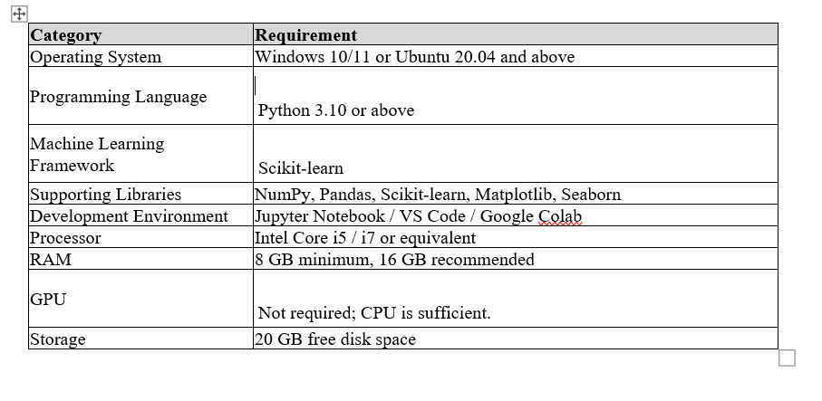
REQUIREMENT ANALYSIS

Slide 6
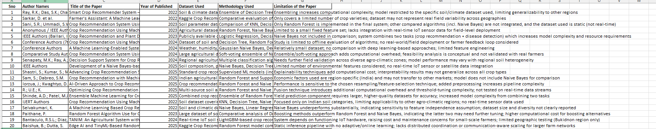
20 Literature papers

Slide 7
DATASET Description
The Crop Recommendation dataset used in this project contains 2,200 records and 8 attributes.
The dataset consists of 7 agricultural and environmental input features: Nitrogen (N), Phosphorus (P), Potassium (K), Temperature, Humidity, Soil pH, and Rainfall.
The dataset contains 22 different crop classes, including rice, maize, chickpea, kidneybeans, pigeonpeas, mothbeans, mungbean, blackgram, lentil, pomegranate, banana, mango, grapes, watermelon, muskmelon, apple, orange, papaya, coconut, cotton, jute, and coffee.
Each crop class contains approximately 100 records, making the dataset balanced across the crop categories.
The dataset contains numerical input attributes and a categorical target variable (label), making it suitable for multi-class classification.
The dataset is used to train and evaluate Random Forest and Naive Bayes machine learning algorithms for crop recommendation.
Since the dataset is already balanced, SMOTE and random undersampling are not required.
The models can be evaluated using accuracy, precision, recall, F1-score, and confusion matrix.

Slide 8
THANK YOU

